Slide 1
University of Missouri Research Board Why this, why now, why me?
Mariesa L. Crow
crow@mst.edu

Slide 2
Some Logistics
https://umresearchboard.missouri.edu/Login.aspx

Slide 4
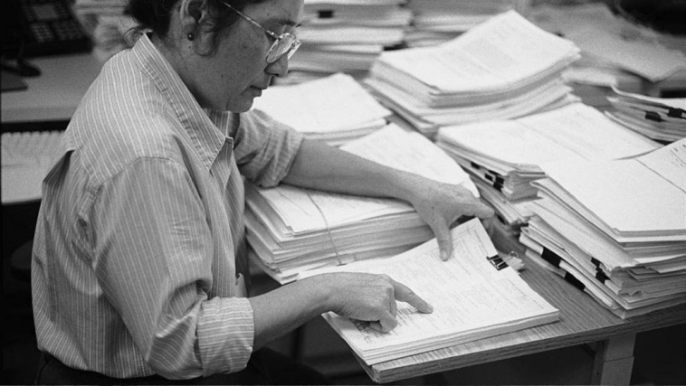
Review Process
Engineering
Life Sciences
Humanities and Fine Arts
Physical Sciences and Mathematics
Social and Behavioral Sciences
You will need to select the most appropriate subcommittee to review your proposal

Slide 5
Application Tips
Follow the instructions
Possible Reviewers – helpful, but sometimes problematic
Past & Present collaborators are not appropriate
External reviewers are encouraged

Slide 6
Bibliography
No more than 2 pages
Single-spaced
Include complete reference (name, title, journal, etc) Use whatever bibliographic style is typical for your field

Slide 7
Making the Budget
Salaries – PI, graduate students, post-docs for no more than 12 months
Fringe benefits – 35.37% for PI/post-doc, 0% for students
Travel is not allowed, except for visiting sites or project collaboration
Be aware that most budgets are cut at award time

Slide 8
Narrative
Number the pages
Double-spaced
Brief, yet consistent with critical peer review
Minimum of two pages, no more than 10 pages
"Revised Proposal" The first page must include an explanation section that explains how the proposal has been changed
Images/graphics -- convert to .jpg file before inserting

Slide 9
Narrative
A statement of overall and specific objectives
Background and rationale
Preliminary work/results
Significance of the project to research or creative activity in the specific field, and its potential value in enhancing the stature of the University
Project design and procedures proposed to accomplish the objectives
Resources and environment (describe relevant support facilities and services, intellectual resources, etc.)
Explanation of the reason the research board is asked to support the project (is external support unavailable, insufficient, interrupted, etc.)
Plans for future support for this or closely related projects; specifically, state how research board support would increase your potential to obtain extramural funding, and
REVISED PROPOSALS should include your response to previous peer reviews.

Slide 10
Attributes of a Successful Proposal
Clear, concise project objectives
Strong motivation (need for research)
Thorough analysis of the state-of-the-art (background)
Clear research progression with definable milestones
Adequate resources (laboratory, team expertise)

Slide 11
Project Objectives
Single most important part
Focus reviewers’ interest
A clear concise statement of intended contribution to field
Significance of contribution
The reviewers read your proposal, not your mind

Slide 12
Do
Have a research plan
Build on your strengths
Differentiate this proposal from your Ph.D. work
Perform a thorough state of the art search
Read the submission guidelines
Submit early!

Slide 13
Don’t
Rush
Wait until the last minute
Make the proposed work too broad
Make the proposed work too narrow

Slide 14
Advice
Think about where you want to be in five years, ten years, twenty years
How will this (your first funded research) get you there?

Slide 15
My UMRB story
I joined MST in 1991
UMRB was established in 1992
Wrote my first UMRB with a colleague (fellow asst. professor) in 1995 – we combined our two expertise areas – power systems (mine) and power electronics (his) for $50,000.
That project laid the groundwork for the rest of my career (power electronic applications to power systems – FACTs, ESS, renewable energy, microgrids)
I’ve had over $22M in funded research

